Slide 1
Computer Types:
Definition of Computer:
Fast Electronic Calculating machine
Input: Digitized info
Process: Digitized info as per the stored instructions
Output: Resulting information
Program: The list of instructions that process Digitized info to produce the output
Memory: Internal storage

Slide 2
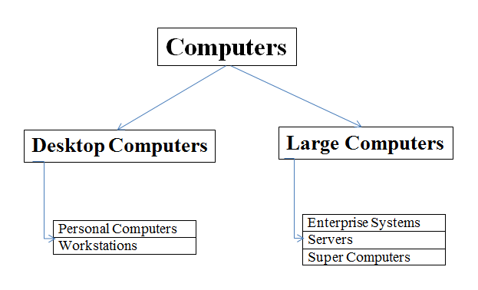
Continued…
Types:

Slide 3
Continued…
Computers are classified into Desktop Computers and Large systems based on Size, Cost, Computational Power
Desktop Computers:
General Properties:
They have Processing units, Storage units, Visual display, Audio O/P units, Keyboard
Point(s) specific to Personal Computers:
Most Common form of desktop computers
Uses: Homes, Schools, Business offices
Portable notebook computers are compact flavor of PCs i.e., all the components are packaged into an unit
Point(s) specific to Work Stations:
This has high resolution graphics I/O capabilities
Computational Power(Work Stations)>Computational Power( PCs)
Uses: Engineering applications

Slide 4
Continued…
Large Systems:
General Properties:
Large and very powerful than Desktop Computers
Multiple Processors, Technology like Parallel programming
Enterprise Systems, Servers at the lower end of the range, Super Computers at the higher end
Point(s) specific to Enterprise Systems
Enterprise Systems/Mainframes
Used in business data processing in medium to large corporations
Computing power and storage capacity is much more than workstations

Slide 5
Continued…
Point(s) specific to Servers: (IRCTC, GOOGLE….)
They contain database storage
They are capable of handling large volumes of requests
Uses: Education, Business, Personal user communities
Requests and responses are transported over internet
Internet communication happens via high speed fiber-optic links
Point(s) specific to Super Computers:
Used for Large scale numerical calculations
Weather Forecasting applications, Satellite image processing applications, aircraft design and simulation

Slide 6
Continued…
Functional Units:
Introduction:
A computer has 5 functionally independent parts
They are input, output, memory, control, arithmetic and logic units
Input and Output units are collectively called I/O
ALU and Control units are collectively called Processor
Next Slide

Slide 7
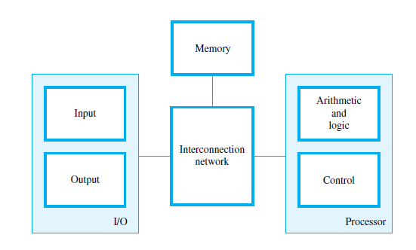
Continued…
Functional Units Diagram:

Slide 8
Continued…
Input unit accepts coded info from electromechanical devices like keyboard , from other computers over digital communication links
Memory stores the inputted data for later reference
Inputted data may be given directly given to ALU and performs arithmetic/logic operations (Program stored in memory)
Output unit sends the result to the outside world
Control unit coordinates these actions
There are several ways in which these units can be connected

Slide 9
Continued…
Info handled by a computer:
Instructions/Values/Addresses-----Data
About instructions:
Specify arithmetic, logical operations to be performed
Govern transfer of info within computer, between computer and I/O devices
Program is a list of instructions
When a program is to be executed it must be in memory
Processor fetches the instructions of the program to perform operations

Slide 10
Continued…
Difference between values and addresses
Values can be numbers/characters
But addresses are numbers(integers in binary)
Example wherein a program can be called data
Compiler
Information handled by a computer must be encoded in suitable form?
Alphanumeric characters: ASCII (to denote a character 8 bits)

Slide 11
Continued…
Input Unit:
Computers accept coded info through input units
Keyboard
What happens during a Key press?
When a key is pressed the ascii value for the key gets stored in a memory location
Others include joysticks, trackballs, mouse
Graphic input devices

Slide 12
Continued…
Memory Unit:
To store programs and data
RAM: (Primary memory/Main memory)
Memory has a large no of semiconductor storage cells each of which will store one bit
Individually they are rarely read/written
Instead they are read/written in groups
?
Word (16 to 64 bits and depends on ALU)
Memory is organized in a way that a word can be read/written in an operation

Slide 13
Continued…
Addresses are associated with words for easy retrieval
Address and control command
Memory capacity determines size of computer
Smaller machines---tens of millions of words
Larger--- hundreds of millions of words
For memory word is the basic building block
RAM---Random Access Memory
Memory where any word can be accessed in the same amount of time
Memory Access Time?
Time required to access a word
In modern RAMs it is few ns to 100ns
Cache---Small, fast RAM unit(s)

Slide 14
Continued…
ALU:
Most of the operations are executed in ALU
Addition of 2 numbers. How?
Any other operation like mul, comparison can be done by bringing operands into processor and operation being performed by ALU
Operands are stored in the registers of the processor
CU and ALU are many times faster than other computer devices.
That is how processor controls a number of devices

Slide 15
Continued…
Output Unit:
Counterpart
Send processed results outside
Printer
Ink Jet printers, Laser printers (photocopying technique—Xerox machines) for printing
We can have a printer that prints 10000 lines/min
This speed may be great for mechanical device but nothing in front of processor speed

Slide 16
Continued…
Control Unit:
The operations of input, output, memory, ALU must be coordinated
CU
Its job is to send control signals to other units to get to know the states
I/O transfers, input and output operations are controlled by instructions
But then actual timing signals for transfers are generated by CU
Timing signals determine when a given action has to take place
Data transfers b/w processor and memory are also controlled by CU
CU theoretically can be thought of as a unit that interacts with other parts
In practice the circuitry is spread throughout the machine

Slide 17
Basic Operational Concepts:
Program in memory
Individual instructions are brought from memory into processor (also data ) to perform the operations
Ex1: Load R2, LOC
This instruction reads the contents of a memory location whose address is represented symbolically by the label LOC and loads them into processor register R2.
The original contents of location LOC are preserved, whereas those of register R2 are overwritten.
Ex2: Add R4, R2, R3
adds the contents of registers R2 and R3, then places their sum into register R4. The operands in R2 and R3 are not altered, but the previous value in R4 is overwritten by the sum.

Slide 18
Continued…
Ex3: Store R4, LOC
This instruction copies the operand in register R4 to memory location LOC.
The original contents of location LOC are overwritten, but those of R4 are preserved.
PTO

Slide 19
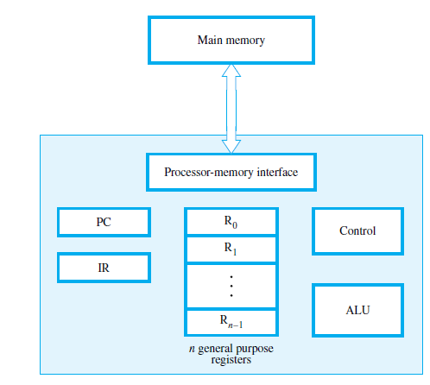
Continued…
Connections between memory and processor (one of the ways)

Slide 20
Continued…
IR—Instruction Register
It holds the instruction currently being executed
PC—Program Counter
It contains the address of the next instruction to be fetched and executed
During the execution of an instruction PC is updated
General purpose registers hold addresses/values (R0-Rn-1)

Slide 21
Continued…
Only 2 registers communicate with memory
MAR—Memory Address Register
MDR—Memory Data Register
MAR holds the address of location to be accessed
MDR holds the data read from/written into the addressed location
Scenario: MAR, MDR, Control Signal
1. Instruction has to be fetched whose address is in PC
2. Data has to be fetched from memory
3. Result has to be stored in memory

Slide 22
Continued…
Interrupts?
A request from I/O devices
Scenario: I/O device wants immediate attention of Processor
Sends interrupt signals
Processor before servicing the interrupt saves the PC, GPR of the current program
Processor executes ISR for that interrupt
Can be returned to the previously executing program

Slide 23
Numbers:
Computers operate on info represented by 2 electric signals 0 and 1
01000111001010—Bit/Binary digit
What is the way to represent numbers and characters?
String of bits
Number representation:
Unsigned integers
A n-bit vector can represent unsigned integers in the range?
0 to (2^n) -1

Slide 24
Continued…
It is equally impt to represent signed numbers
How?
3 Systems
1. Sign and Magnitude
2. 1’s Complement
3. 2’s Complement
Thing that is common to all 3 is for +ve numbers MSB is 0, for –ve numbers MSB is 1
Positive values have identical representation in all 3 systems but negatives have different representations

Slide 25
Continued…
Sign and Magnitude:
In this system 1 bit (MSB) is reserved for sign and the rest of the bits to represent magnitude
Ex: +5 (4-bit binary format)
0101
Ex: -5 (4-bit binary format)
1101
Just change the MSB from 0 to 1 if the negative value of a positive value needs to be represented
Next Slide

Slide 26
Continued…
1’s Complement:
For +ve numbers:
Normal Binary form (Unsigned number)
For –ve numbers:
The binary rep of the corresponding +ve number is taken and all bits are complemented
Ex: +7 (4-bit format)
0111
Ex: -7 (4-bit format)
Take binary rep of +7 and complement all bits
1000

Slide 27
Continued…
2’s Complement:
Ex: +7 (4-bit binary form)
0111
You subtract this from 10000
What you get is 1001 which is the 2’s complement for -7
Table (PTO)

Slide 28
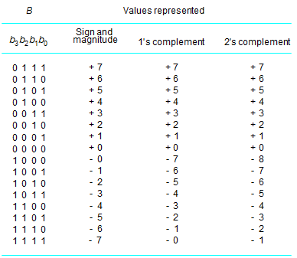
Continued…

Slide 29
Continued…
Sign and magnitude, 1’s complement have diff representations for +0 and -0
But 2’s complement has only one representation
-8 has representation only in 2’s complement form
2’s complement is the most efficient way to carry out arithmetic operations
Arithmetic Operations:
Addition of Positive/ Unsigned numbers (4-bit binary format)
Adding 15 with 15 (30)
1111 with 1111 (11110) Now the carry generated as a result of addition is considered overflow since overflow has occurred

Slide 30
Continued…
Addition and Subtraction of Signed numbers
When the 2 nos that are to be added are in the range of system and if after addition the result is in the range of the system then no overflow has occurred. Carry generated if any in this case will not be considered overflow (+7+(-3))
When the 2 nos that are to be added are in the range of system and if after addition the result is not in the range of the system then overflow has occurred. Carry generated in this case will be considered overflow -7+(-2)= -9
When 2 operands have same sign and the MSB of the result is of opposite sign then overflow is said to have occurred -7+(-2)= -9

Slide 31
Continued…
Addition rules:
Add
If the result is in the range, any carry generated is ignored
If the result is out of the range, carry generated in that case is considered overflow
Subtraction rules:
X-Y
Find 2’s complement for Y and add it to X
Addition rules apply here

Slide 32
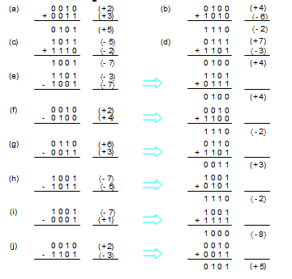
Continued…

Slide 33
Continued…
Sign Extension?
Suppose if I want to store -8 in 16-bit register
The sign bit is extended to the rest of the bit positions for the value to be retained
2’s complement is used for signed numbers rep in modern computers

Slide 34
Continued…
Characters:
Computers should handle text also
Representing characters, digits as characters, punctuations is impt
ASCII character set

Slide 35
Performance
The most imp measure of the performance of a comp is how quickly it can execute prgms.
The speed with which a comp executes pgms is affected by the design of its instr set, its H/W and S/W including OS, and the technology in which the H/W is implemented.
Technology
Parallelism
a) Instruction-level Parallelism: pipelining
overlap the exec of the steps of successive instrs.
Total exec time will be reduced.
b) Multicore Processors: dual-core, quad-core, and octo-core processors
c) Multiprocessors: shared-memory multiprocessor
message passing multicomputers

Slide 36
We need a system that can accommodate very large integers and very small fractions and that system should take care of point because in FP nos point is not fixed its variable
Floating point representations
What constitute the representation?
Sign, String of digits (Mantissa) and exponent constitute the representation
Next Slide

Slide 37
Continued…
IEEE standard for floating point nos:
3 standards/formats
Single precision---32 bit format
Double precision--- 64 bit format
Single Precision:
In single precision format, 1 bit for sign, 8 bits for exponent, 23 bits for mantissa

Slide 38
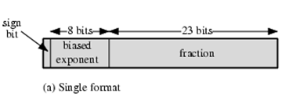
Continued…

Slide 39
Continued…
Biased Exponent/ Exponent in Excess 127 representation
?
To store the signed exponent as an unsigned integer
If the original exponent is -100
Then it will be biased to 27
Which value is represented by the single precision format 0|00101000|001010 (Normalized version)
?
Represent -23.75 in single precision format

Slide 40
Continued…
Special Cases:
Using 8 bits we can represent signed exponent in the range -128 to +127
Exponents are biased
The range of values of biased exponent if the exponent field has 8 bits is 0 to 255
But 0 and 255 are special values
The range is 1 to 254
Hence the range of signed unbiased exponents that can be represented is -126 to +127
23 bits represent fractional part of mantissa
It is called single precision since it occupies a single 32 bit word
Scale factor of 10^-38 to +10^+38 is possible here

Slide 41
Continued…
Double precision:
It occupies 2 32 bit words
1 bit for sign
11 bits for exponent
52 bits for mantissa
Here also the exponent is biased and the biasing value is 1023 (2^(n-1)-1)
Range of biased exponents: 1 to 2046 (0, 2047 special values)
Range of signed unbiased exponents: -1022 to +1023
Scale factor: 10^+308 , 10^-308 is possible here

Slide 42
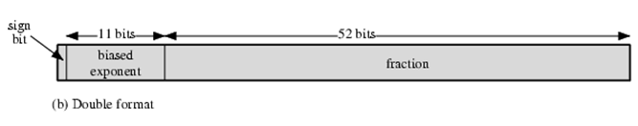
Continued…

Slide 43
Continued…
Special Values:
E’= 0 && M=0 (exact zero) or E’=255 && M=0 (Infinity)
The corresponding Es are -127, +128
Now let’s say I am adding 2 binary fractions that are in single precision whose exponents are -126, -126 and let’s say the exponent of the result is -127 and M=0
?
Underflow has occurred and the result is 0 (+ or -)
If exponent is -127 and M!=0 then the result is a denormal number (smaller than normal)
Similarly, let’s say I am adding 2 binary fractions that are in single precision whose exponents are 127 and 127 and let’s say the exponent of the result is +128 and M=0
?
Overflow has occurred and the result is infinity (+ or -)

Slide 44
Arithmetic operations:
Addition
Subtraction
Multiplication
Division
Rules are given with respect to single precision format and these rules can be used for format that is of less or equal length of single precision
Next Slide

Slide 45
Continued…
Addition/Subtraction rules:
1. Convert the given decimal fractions to binary fractions
2. Normalize the converted binary fractions
3. Sign of the result: Sign of the number with the largest exponent is the sign of result
4. Find the biased exponents and represent the numbers
5. Take the number with smaller exponent and logical right shift its mantissa by difference in the exponents (Don’t forget the 1 that is not represented).Now the exponent of this number would have become equal to the exponent of no with larger exponent
6. Add/Subtract the shifted mantissa of the no in step5 with the unshifted mantissa of the other number
7. Normalize the final answer, Represent it in single precision and check the answer for correctness

Slide 46
Continued…
The numbers have to be represented in single precision and same is the result
1. 1.25+0.25
2. 1.25-0.25
Multiplication Rules:
1. Convert the given decimal fractions to binary fractions
2. Normalized the converted binary fractions
3. Sign of the result is the XOR of sign of 2 nos
4. Find the biased exponents and represent the numbers
5. Add the biased exponents and subtract 127
6. Multiply mantissas: (Don’t forget the hidden 1) and keep the result obtained
7. Normalize the mantissa if required and add the generated exponent to the biased exponent obtained in step 5
8. Represent the result in single precision
9. Check the correctness of the result

Slide 47
Continued…
Multiply : -5.75 *1.5=-8.625
Division Rules:
1. Convert the given decimal fractions to binary fractions
2. Normalized the converted binary fractions
3. Sign of the result is XOR of sign of 2 nos
4. Find the biased exponents and represent them
5. Subtract the biased exponents and add 127
6. Divide mantissas: (Don’t forget the hidden 1) and keep the result obtained
7. Normalize the mantissa if required and add the generated exponent to the biased exponent obtained in step 5
8. Represent the result in single precision
9. Check the correctness of the result

Slide 48
Continued…
Division: -5.75/1.5=-3.833333………….
Guard Bits and Truncation:
We have guard bits (3)
First bit is guard bit, second bit is round bit, third bit is sticky bit
When bit value 1 comes into sticky bit ,1 is retained
This yields more accurate final result

Slide 49
Continued…
Suppose if the final result is to be rounded off
?
Rounding techniques are there
1. Chopping
2. Von Neumann Rounding
3. Rounding
1. Chopping: Let’s say I want to truncate from n bits to m bits
Simply the n-m bits from right to left are chopped

Slide 50
Continued…
2. Van Neumann rounding:
If the bits to be removed are all 0s they are chopped
If any one is 1, then the LSB of retained bits set to 1
3. Rounding:
If the MSB of the bits to be removed is 1, then 1 is added to the LSB of retained bits
Best method

Slide 51
Continued…
Round the final result 1.110110 from 6 bits to 3 bits in the fraction part using
1. Chopping
2. Van Neumann
3. Rounding
Guard bit, Round bit, Sticky bit + Rounding:
G=1, R=1 add 1 to LSB (Round UP)
G=0, R=0||1 No change (Round down)
G=1, R=0 Look at S
If S=1 Round Up
If S=0 Round to nearest even (If LSB is 0 leave it or else add 1 to LSB)

Slide 52
Continued…
A=0 10001 011011
B=0 01111 101010
Do Subtract, Truncate the result using rounding

Slide 53
Floating point Arithmetic
Addition
Subtraction
Multiplication
Division
IEEE 32-bit single precision
IEEE 64-bit single precision
FOR FLOATING POINT PORTION
As per the syllabus floating point portion is from William stallings Text 2).
But it is covered from Hamacher Text 1.
9.7
9.7.1
9.7.2

